Slide 1

AMCAT dataset EDA

Slide 2
About me
Hello there! I’m Zaheer(IN_1240549), a data science enthusiast currently interning at Innomatics Research Labs.
When it comes to academics, I graduated with a Bsc in 2023. Driven by a passionate interest in data science, I chose to pursue further learning at Innomatics Research labs. Currently, I’m gaining hands on experience as an intern in the field
Sure thing! Feel free to get in touch whenever you’d like. Whether it’s about data science, career advice, or just to chat, I’m always available and happy to connect with you.

Slide 3
Problem Statement
• AMEO dataset provides anonymized bio data information along with their respective skill scores and employment outcome information. As part of the challenge, the aim is to find the relationship between salary vs remaining features to know which are more affecting the salary column. Based on the analysis finding the insights.

Slide 4
Brief About Data
•Most of the engineering students in the data are males.
•Majority of the students in 10th and 12th standard are from state board followed by CBSE board.
•Tier 2 colleges dominate the data just like they dominate in the real world meaning that only a few colleges are tier 1 colleges
•B Tech/ B.E clearly dominates other degrees in terms of frequency of occurrence
•The specialization has been manually categorized into 5 buckets with majority of students specializing in computer science, followed by Electronics/Electrical, IT, Mechanical and others.
•Majority of the data belongs to students who went to a college in Uttar Pradesh Data was checked for all the assumptions of linear regression and all of them were duly satisfied

Slide 5
Objective of the Project
This Analysis aims to gain insights and understanding from the provided dataset, particularly focusing on the relationship between various features and the target variable, which is Salary. Specifically, the goals of this analysis include:
• Describing the dataset and its features comprehensively
• Identifying any patterns or trends present in the data.
• Exploring the relationships between independent and target variables (Salary).
• Identifying any outliers or anomalies in the data

Slide 6
Summary of Dataset
The Aspiring Mind Employment Outcome 2015 (AMEO) dataset, released by Aspiring Minds, focuses on employment outcomes for engineering graduates. It includes dependent variables such as Salary, Job Titles, and Job Locations, along with standardized scores in cognitive skills, technical skills, and personality skills. With around 40 independent variables and 4000 data points, these variables encompass both continuous and categorical data. The dataset also includes demographic features and unique identifiers for each candidate.

Slide 7

Exploratory Data Analysis
Step 1: Data Cleaning
Removing Unwanted Columns
Data Type Conversion
Collapsing Categories
Step 2: Data Manipulation
Adding a Tenure Column
Imputing Categorical column with mode values
Validating 10, 12 percentage, and College GPA
Checking the condition of DOL > DOJ
Imputing Numerical Columns with median values

Slide 8

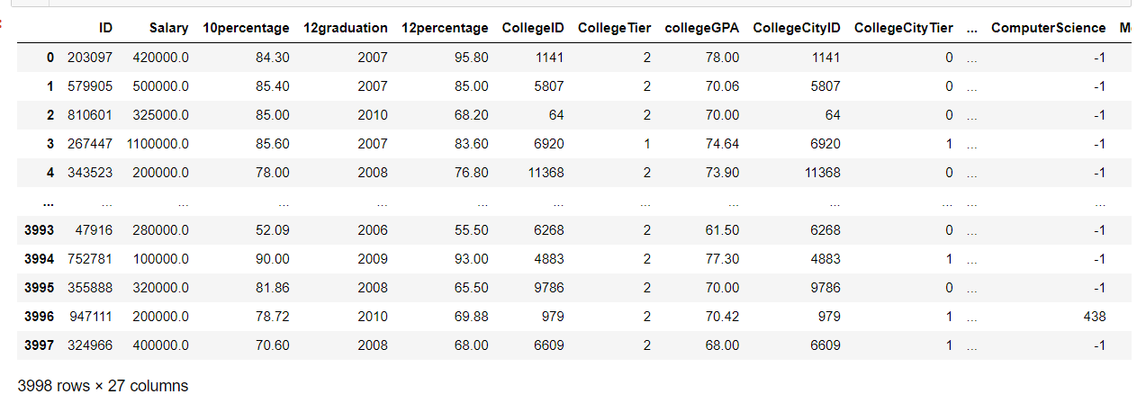
Glimpse of cleaned data

Slide 9
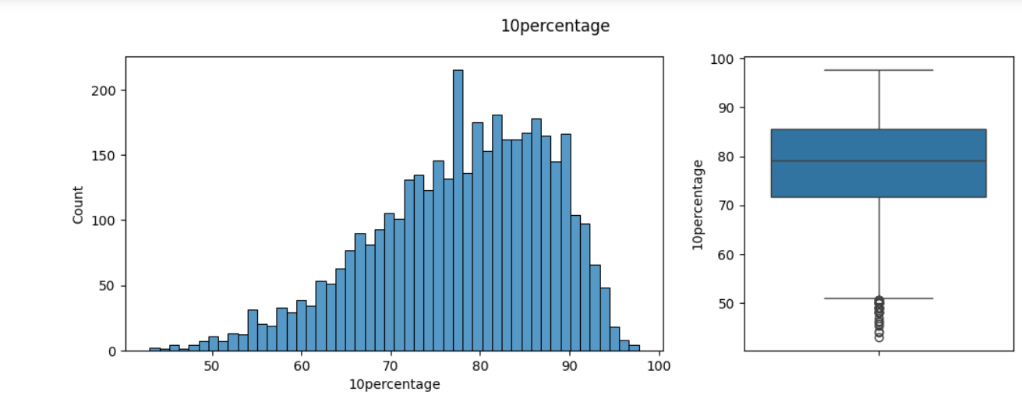
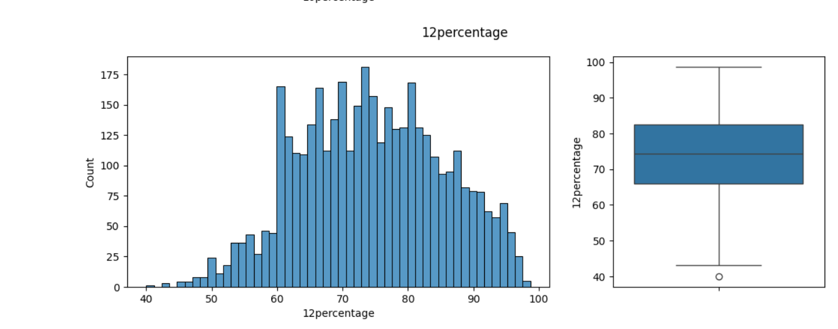
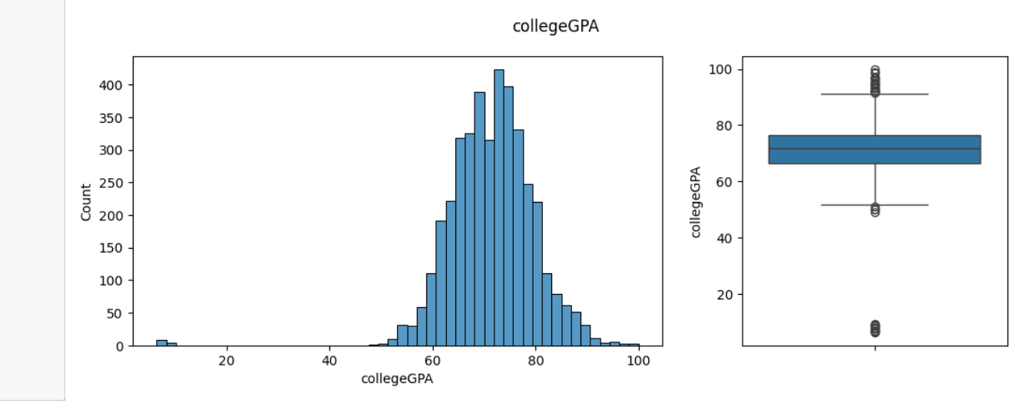
Univariate Analysis
The data indicates a typical range for college GPA lying between 60% to 80%, suggesting a distribution of academic performance among graduates within this range. In contrast, the percentages for 10th and 12th grades show a gradual increase from 60% to 90%, indicating a trend of academic improvement or higher achievement levels as students progress through secondary education. This upward trajectory in secondary school performance could reflect increased maturity, academic focus, or better preparation for college-level studies.

Slide 10
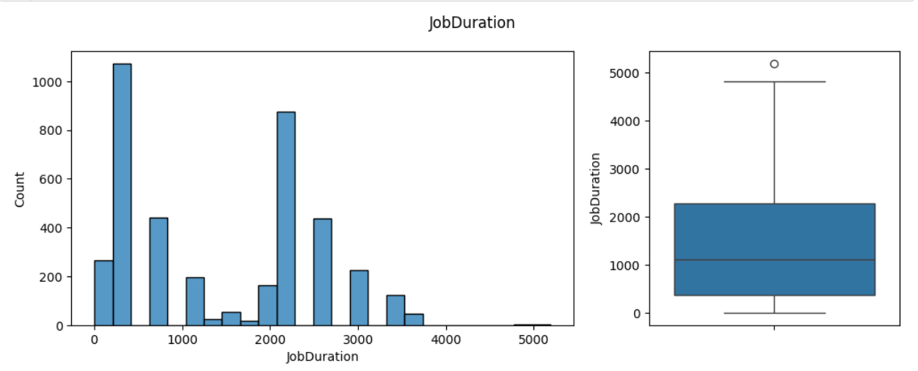
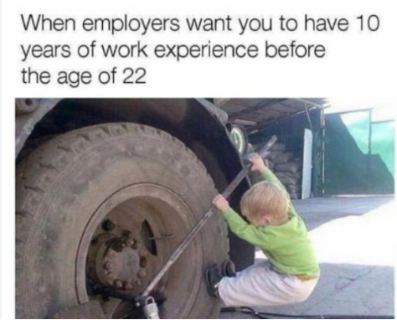
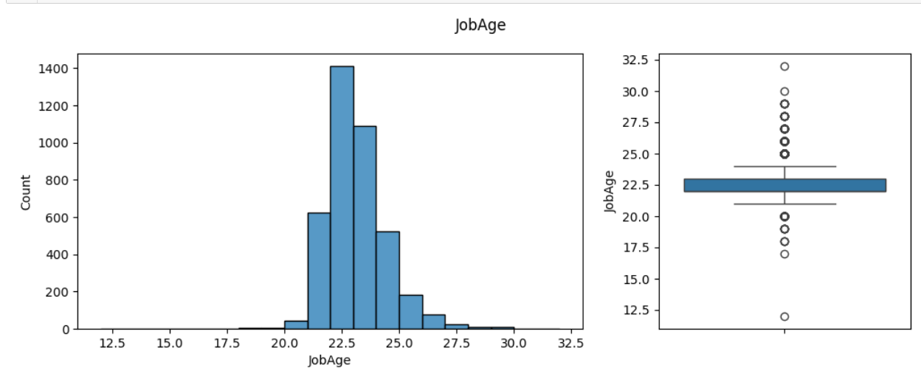
Job age
The average age at which graduates began working is 22.6 years, indicating that most graduates typically enter the workforce shortly after completing their education, which aligns with common expectations.
The majority of graduates are working between 2015 to 2020, suggesting a concentration of employment within this timeframe. This period could coincide with economic trends, job market conditions, or specific events that influenced graduate employment opportunities during those years.
Understanding these patterns can offer valuable insights into the transition from education to employment and the broader socio-economic context in which graduates enter the workforce.

Slide 11
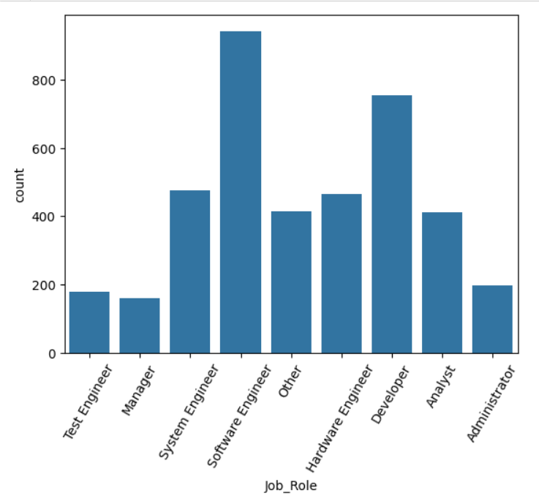
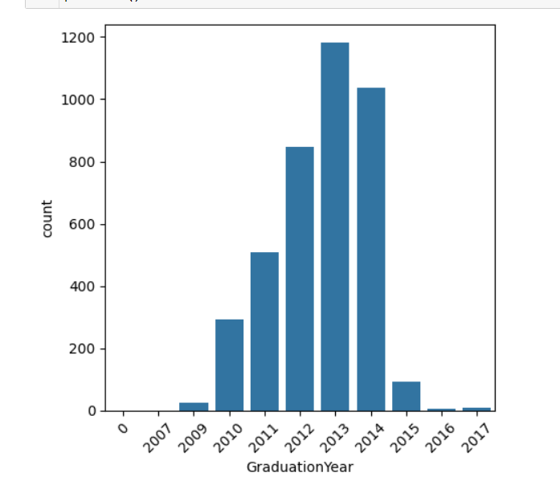

Job role and Graduation year
The peak in graduates in 2013 suggests a potential surge in enrollment or completion rates during that period, indicating a significant cohort of individuals entering the workforce or pursuing further education.
Understanding the reasons behind the spike in graduates in 2013 could provide valuable insights into socio-economic factors, educational policies, or institutional changes that influenced educational outcomes during that specific time frame.
Most graduates specializing in software engineering typically assume roles that involve designing, developing, and maintaining software systems, applications, and solutions to meet specific business or organizational needs

Slide 12
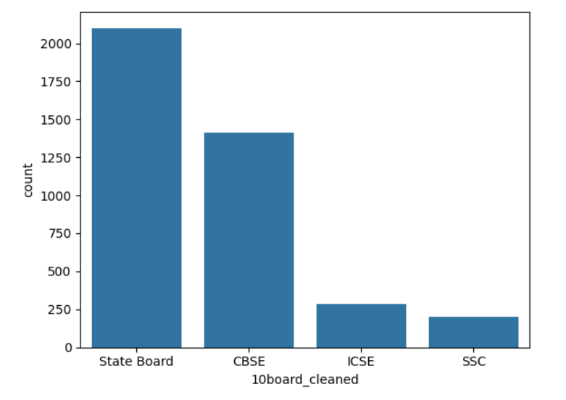
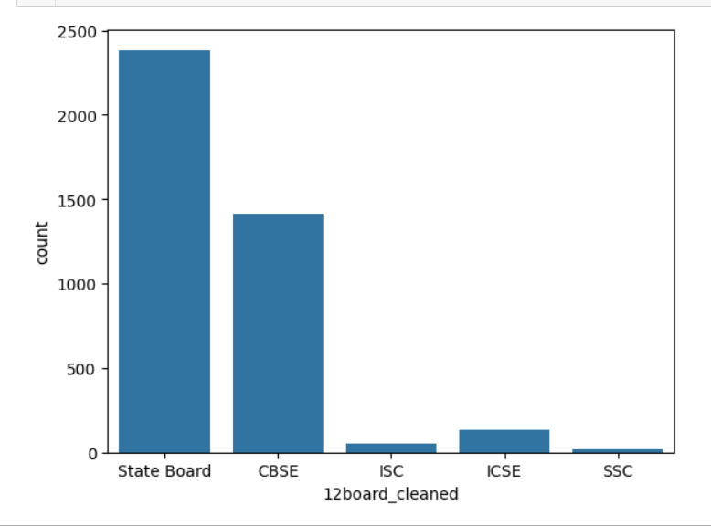
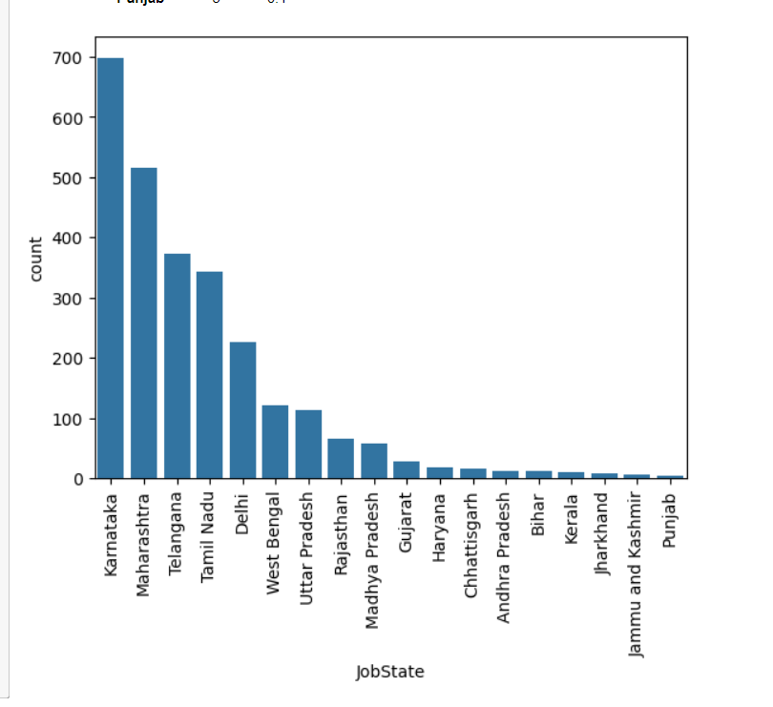
Job state and 10th and 12th Board
Concentration of grads in Bangalore, Noida, Hyderabad, Pune indicates urban job market appeal. Preference for state/CBSE boards suggests trust in quality, shaping educational paths. Tailored workforce strategies needed. Align policies with boards to foster excellence, readiness

Slide 13
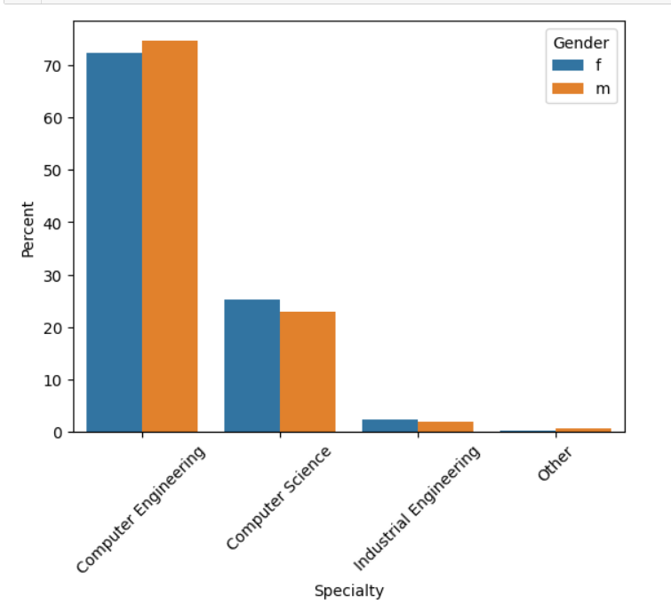
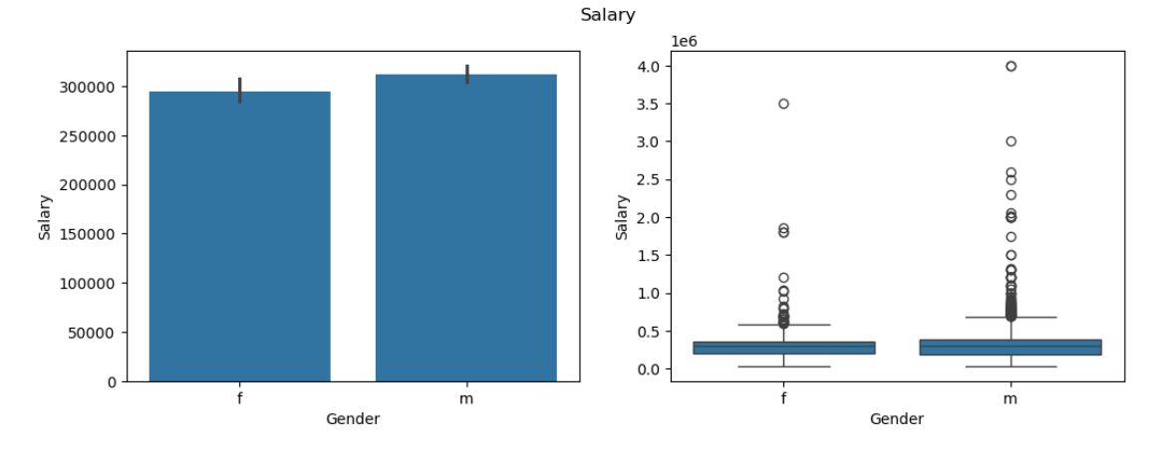
Bivariate Analysis
The data shows a slight variance in mean salary between genders, but determining significance requires further analysis, possibly involving statistical tests to ascertain if the difference is statistically meaningful or due to chance.
Male
v/s
Female
The data indicates a gender preference disparity in specialization choices among graduates: males lean towards computer engineering, while females show a preference for computer science as their field of study. This divergence highlights potential gender-based inclinations or societal influences in career paths within the technology sector.
Male
v/s
Female

Slide 14
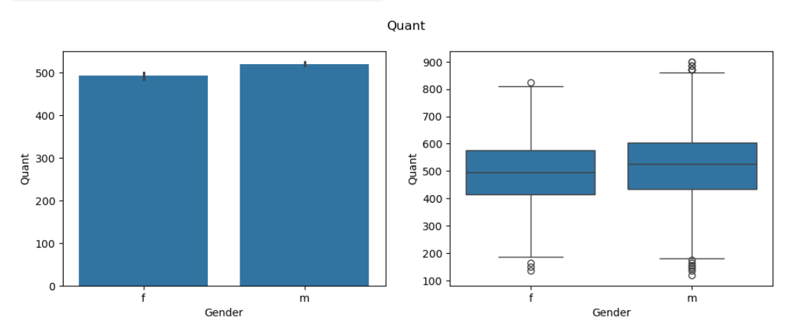
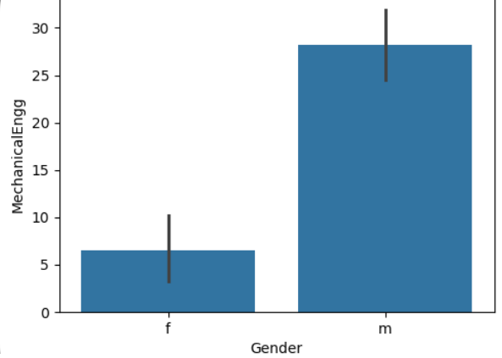
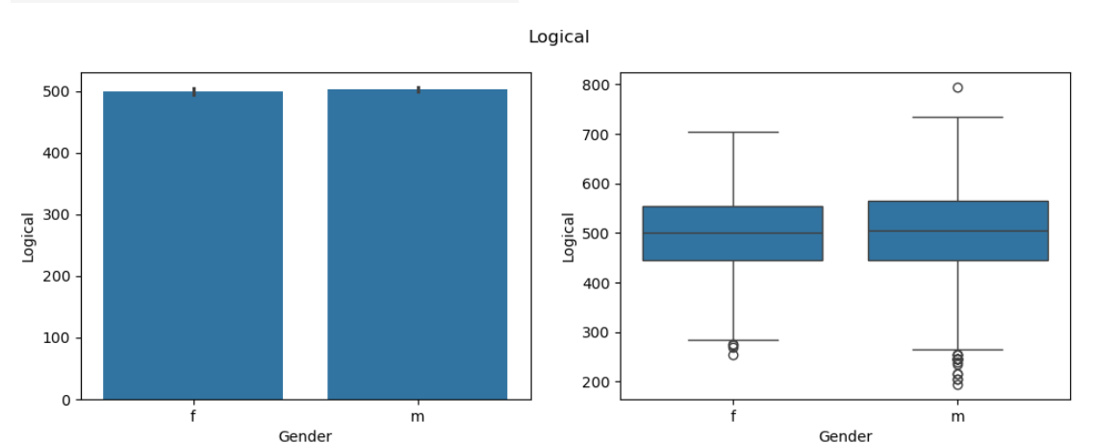
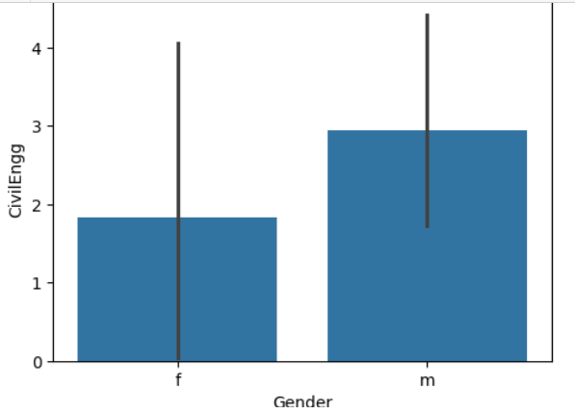
Gender v/s AMCAT scores
In terms of performance, graduates across logical reasoning, quantitative analysis, domain knowledge, computer programming, electronics and semiconductors, and computer science exhibit similar levels. However, male graduates excel comparatively in civil engineering, mechanical engineering, and electrical engineering disciplines. This suggests potential gender-specific strengths or preferences within these engineering fields.
AMCAT Board Scores

Slide 15
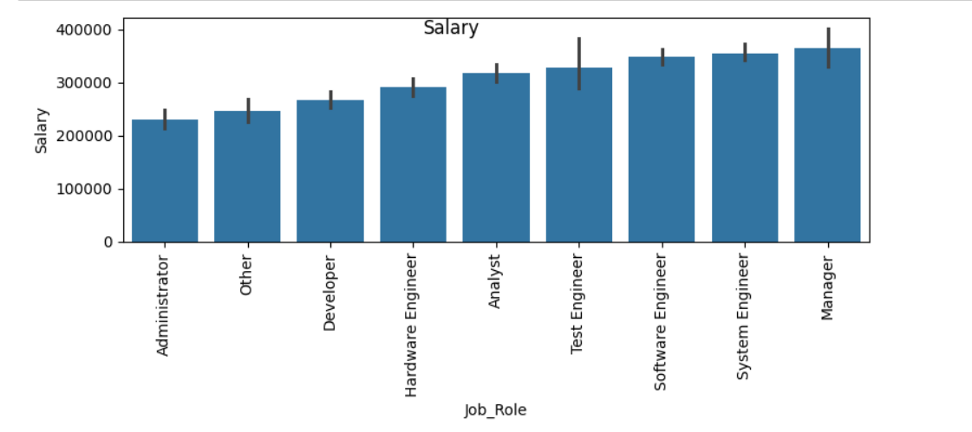

Job role vs salary
Administrator and
Others
Software engineers, system engineers, and managers are notably earning higher salaries in comparison to other roles. This trend underscores the value placed on technical expertise and leadership within the industry, reflecting the demand for specialized skills and managerial acumen in driving organizational success and innovation.

Slide 16
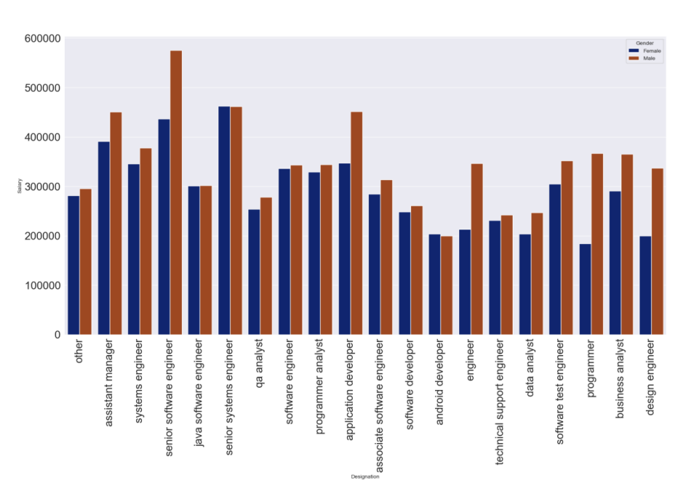

The data suggests a gender disparity in median salaries, with men generally earning higher salaries than women.
This inequality highlights ongoing challenges related to gender pay gaps, which may stem from various factors such as systemic biases, occupational segregation, and negotiation dynamics in the workforce.
Addressing these disparities requires concerted efforts to promote pay equity and create inclusive workplaces where all employees are fairly compensated regardless of gender.
Salary vs Gender

Slide 17
Insights
There exists a robust correlation between 12th-grade performance and that of 10th grade, yet this association does not significantly impact one's collegiate GPA.
Proficiency in English often translates to proficiency in quantitative and logical domains, fostering comprehensive academic excellence.
Students characterized by agreeableness tend to exhibit a heightened receptiveness to new experiences, enhancing their overall academic and personal growth.
Mastery in English, logical reasoning, and quantitative skills invariably leads to superior performance in 10th-grade examinations.
Individuals possessing strong competencies in English, quantitative aptitude, and logical reasoning are poised to secure elevated salary packages and excel academically in both 10th and 12th grades.
The inherent openness of agreeable students primes them for seizing opportunities, potentially culminating in enhanced salary prospects compared to their counterparts.
Female students with advanced educational backgrounds often command higher starting salaries as freshers, outstripping their male counterparts in certain fields.
A commendable personality can serve as a compensatory factor for a lackluster college GPA, particularly in the realm of salary negotiations.
Despite the allure of higher starting salaries in disciplines like polymer technology and computer networking, enrollment rates in these courses remain relatively low.
Proficiency in English, logical reasoning, and quantitative skills not only fosters academic success but also serves as a springboard to lucrative career prospects, underscoring the multifaceted benefits of a well-rounded education.

Slide 18
Research Outcome
Project Objective: The primary goal is to analyze employee data to compare various percentage metrics, focusing on identifying outliers through boxplot analysis.
Comprehensive Analysis: Apart from salary, various other analyses are conducted, aiming to determine factors influencing compensation in the tech industry.
Outlier Identification: Boxplots are utilized to identify outliers within the dataset, allowing for the detection of unusual data points that may require further investigation.
City Concentration Analysis: Countplots are employed to identify cities with a higher concentration of employees, providing insights into regional workforce distribution.
Complex Salary Determinants: The analysis emphasizes the complexity of salary determinants in the tech industry, acknowledging that factors beyond job title or academic credentials play a significant role.
Need for Comprehensive Policies: The findings underscore the necessity for comprehensive compensation policies that consider various factors influencing salary, including location, experience, and skill set.
Talent Management Implications: Further research into the nuanced interplay of these factors could provide deeper insights into effective salary structuring and talent management practices in the tech sector, highlighting potential areas for improvement and optimization.

Slide 19

THANK YOU

